Slide 1
CHATRAPATHI SHIVAJI MAHARAJ…
v.MAHESH

Slide 2
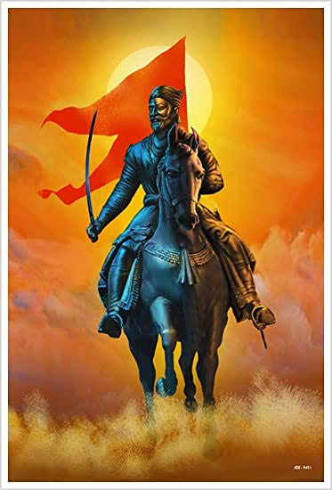
WHO IS SHIVAJI ??
SHIVAJI is a National hero.
He was the founder of the MARATHA EMPIRE.
He was a great warrior of Maharastra.
He was popularly known as the
CHATRAPATI SHIVAJI MAHARAJ.

Slide 3
INTRODUCTION
Shivaji Raje Bhosale was the founder of Maratha Empire in western India in 1674.
He was born on 19 Feb 1627,at Shivneri Fort.
He was died on 3 April 1680.
His parents are Shahaji and Jijabai (who was an great mother made Shivaji an great ruler and strengthen the foundation of the Maratha empire).
He is the first Indian to use the Gourella war.
Shivaji with his ideology of HINDAVI SWARAJ (freedom for the Hindustan)
decided to directly Bijapur Sultanate rule and eventually the Mughal empire
to established the Maratha kingdom for there Marathas.

Slide 4
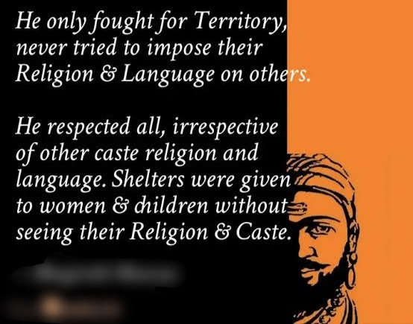
HAVE U EVER THOUGHT THAT WHY SHIVAJI IS GREAT

Slide 5
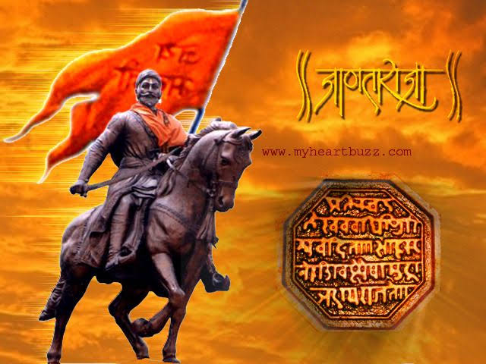
ACHIEVEMENTS
REMOVAL OF SATHI SAHAGAMANAM.
HE ACHIEVED THE FORTS OF RAJGAD,TORANA,KONDANA(SIMHGAD)….
FOUNDED MARATHA EMPIRE.
FOUGHT AGAINST THE MUGHAL EMPIRE.
WON THE BATTLE’S OF PRATAPGARH, KOLHAPUR.
EVEN THE MUGHAL TRIED TO ARREST
UNEXPECTEDLY BY CALLING FOR A TREATY AGREEMENT …HE ESCAPED WISELY.
BECAME FATHER OF INDIAN NAVY BY CONTROLLING OVER 300 PORTS…

Slide 6
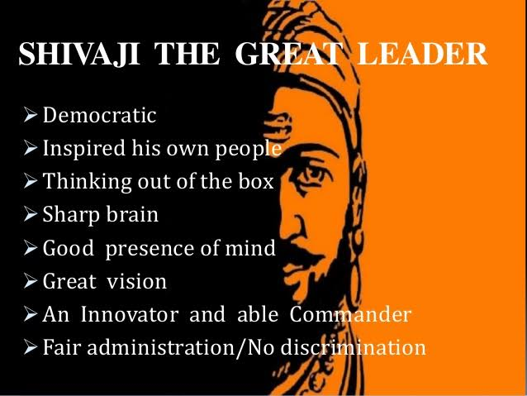

Slide 7
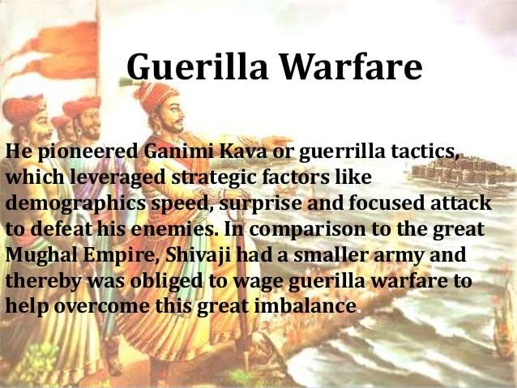
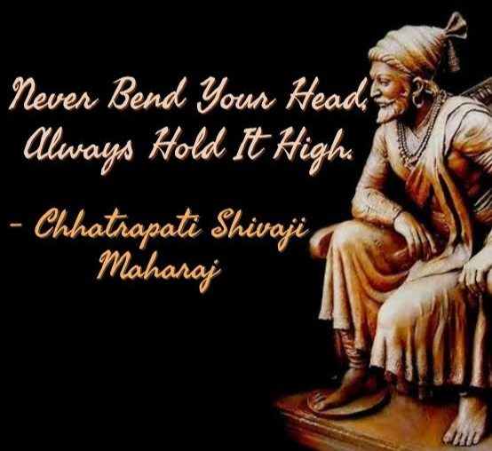
FIGHTING STRATEGY OF SHIVAJI GUERILLA WARFARE USED THIS STRATGY TO WIN FIGHT AGAINST MUGHALS MARCHING 30,000 SOLDIERS TOWARDS MARATHA KINGDOM WITH HAVING 2,000 SOLDIER’S

Slide 8
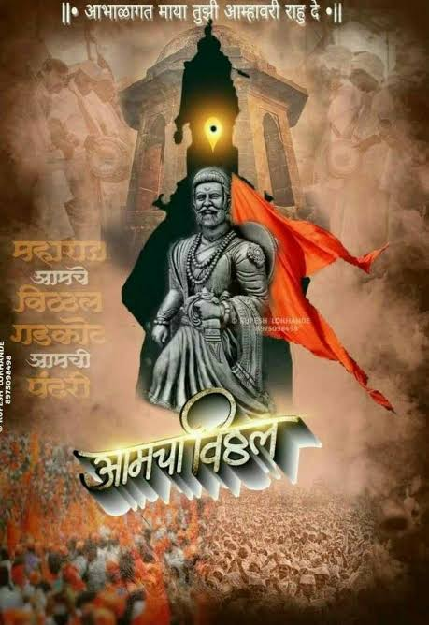
CONCLUSION
HE WAS FIRST INDIAN TO FORM THE GREAT MARATHA EMPIRE AGAINST THE MUGHALS.
HE WAS THE REAL SON OF INDIA REPRESENTING THE TRUE CONSIOUSNESS OF INDIA.
ESTABLISHED A CIVIL RULE WITH WELL-STRUCTURED ADMINISTRATIVE ORGANISATIONS.
EVENTHOUGH OPPOSING THE GREAT MUSLIM RULE(MUGHAL)
HE TREATED ALL HINDUS AND MUSLIM’S IN HIS KINGDOM EQUALLY.
EVEN THOUGH HE WAS DIED PHYSICALLY…BUT HE REAMINS IN THE HEART’S OF INDIAN’S FOREVER….

Slide 9
THANKING YOU

